Slide 1
Developing an ungrounded haptic device to show the self-motion of the vehicle for the automation operating system
Riku M2 0523
Notes:
Today I will report on my work of the this semester, and the content can also be viewed as the outline of my thesis
If you attended last week's roundtable, then you should be very familiar with today’s share,
but since someone didn’t attend it, and also today’s meeting is more like haptic subgroup so I'll go over it again

Slide 2
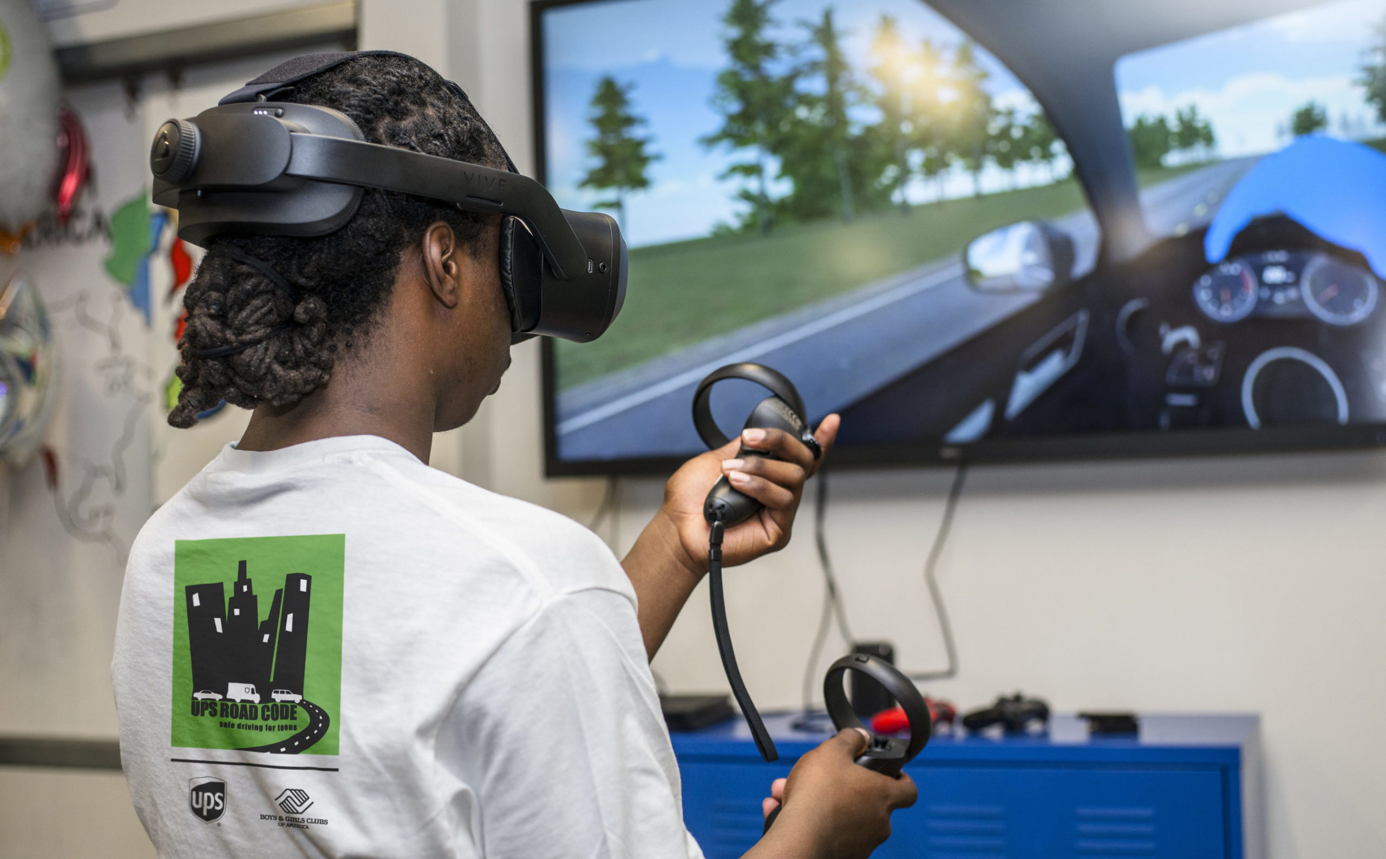
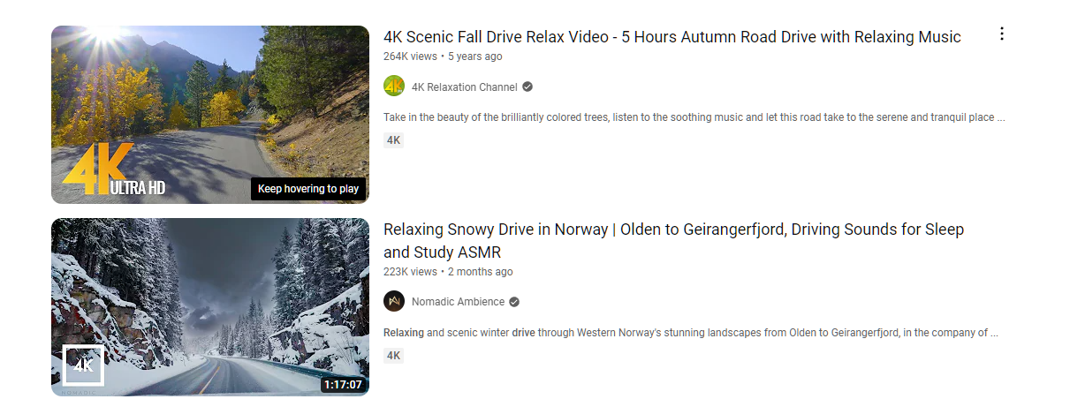
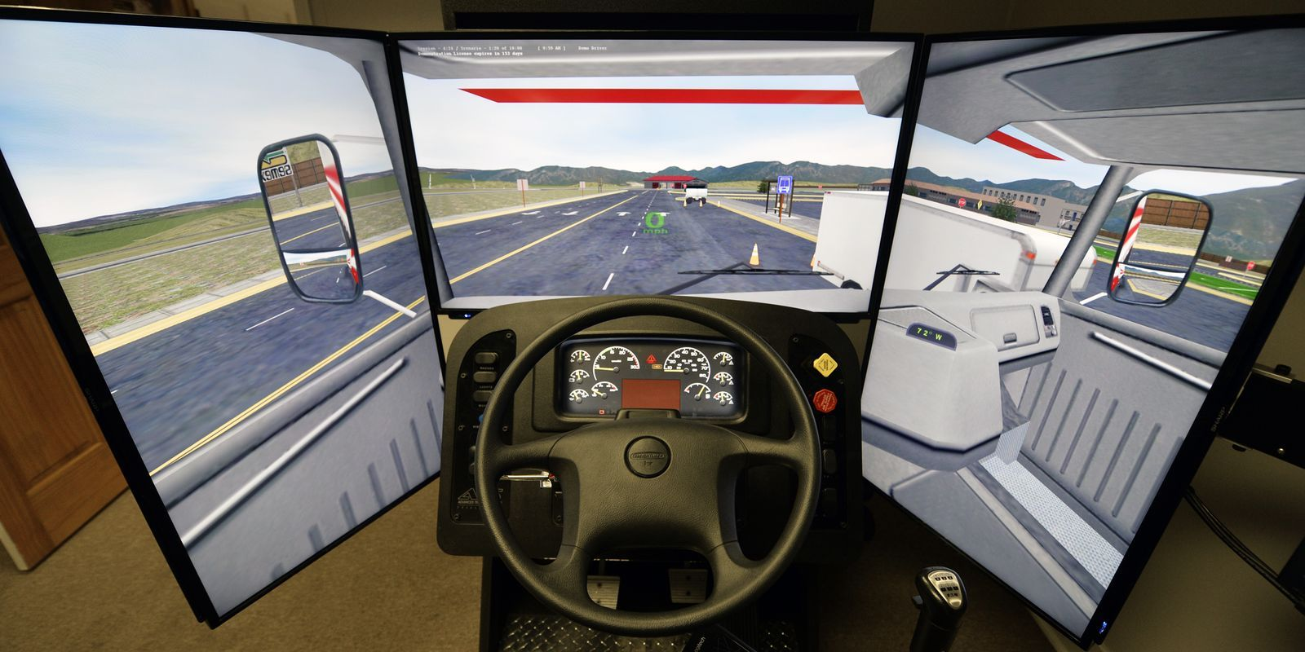
1. Introduction
common driving simulation systems
Notes:
The idea for this project came to me while I was watching a relaxing driving video.
I wondered what would happen if I add the haptic feedback to this kind of video
I also thought that the current driving simulator or game, the haptic info too poor to tell the player the detail of the vehical
Can we ues the haptic tech to pass more information to the users, such as the movement of my vehical, like the direction and speed

Slide 3
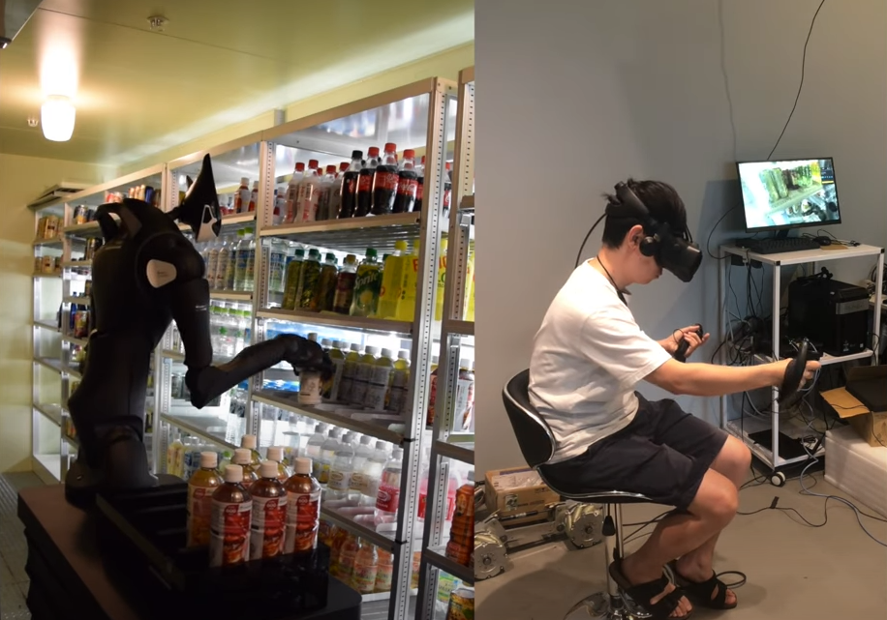
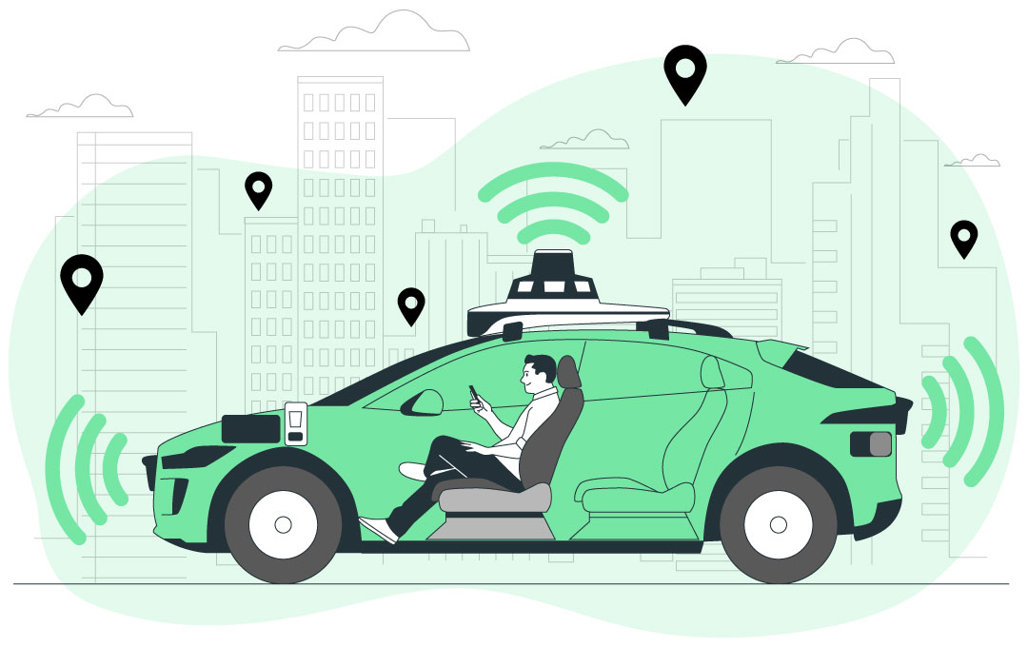
how users interact with automation equipment in the future ?
Notes:
and also like a lot of company are using vr to remote control the robot to do some more complex task and movements no just go forward and back
if we think about more it remind me that how users will interact with automation system in the future
like when the driving ai take over the car, does it means the driver does not need do anything during the driving processing

Slide 4


Active Haptic Perception
concept: haptic interface to deliver the sense of motion to connect the user and automation equipment system
hypothesis: Is there a type of haptic device that can show the motion information of automation equipment and such a device can enhance the user experience and the subjective interaction of the automation system ?
motion haptic
strong connection
Notes:
Based on the above considerations
My idea it is possible to use haptic devices that can show the motion state of the vehcial to keep the sense of connection between the user and the automation system.

Slide 5
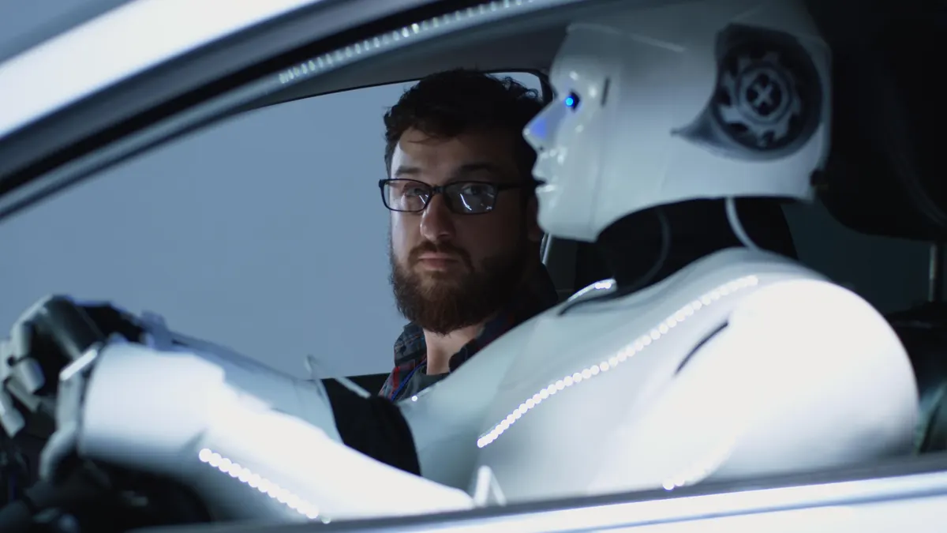
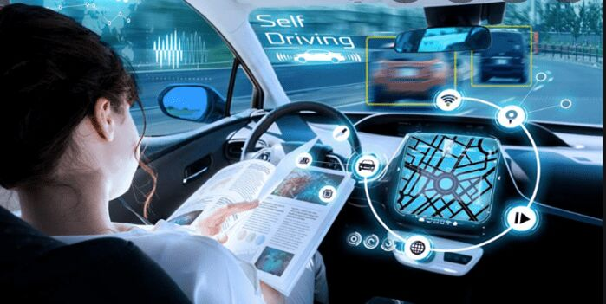
scenarios
The vehicle is controlled by an AI system, but if the user can feel the motion haptic of the car, would they still have the feeling of subjective driving behavior ?
Notes:
Perhaps the concept is still relatively broad, I will take an example here,
when the vehicle is controlled by ai, if the driver can feel the motion state of the vehicle, whether they still feel the subjective driving behavior, they themselves are controlling the vehicle

Slide 6
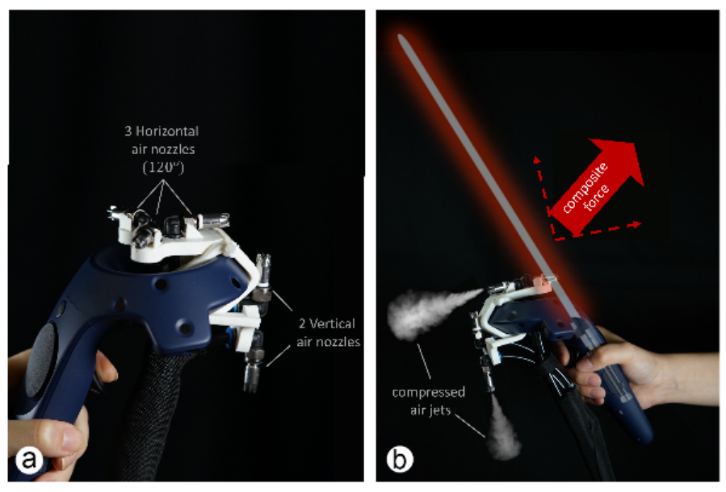
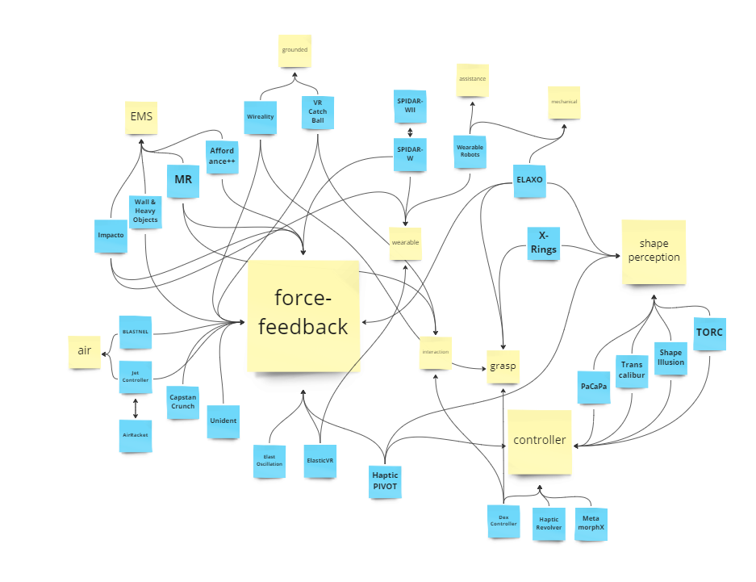
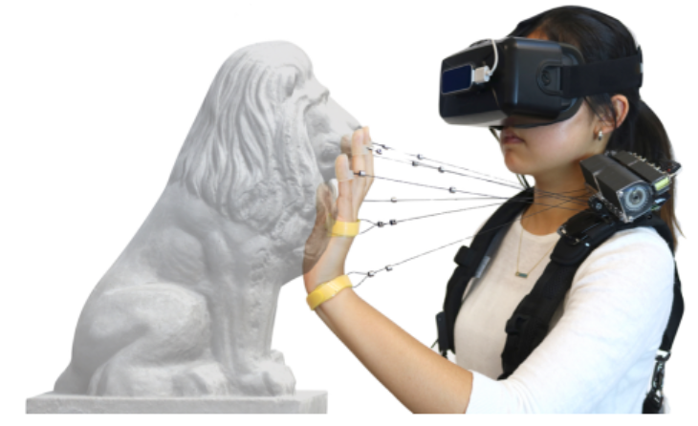
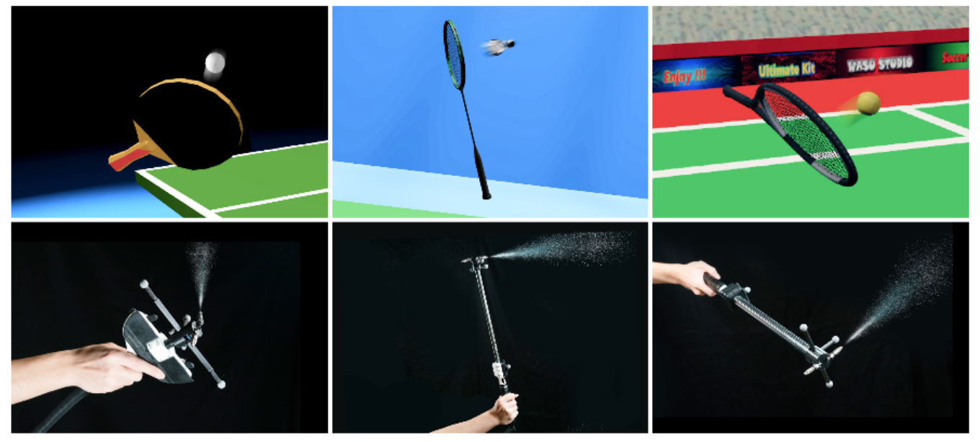
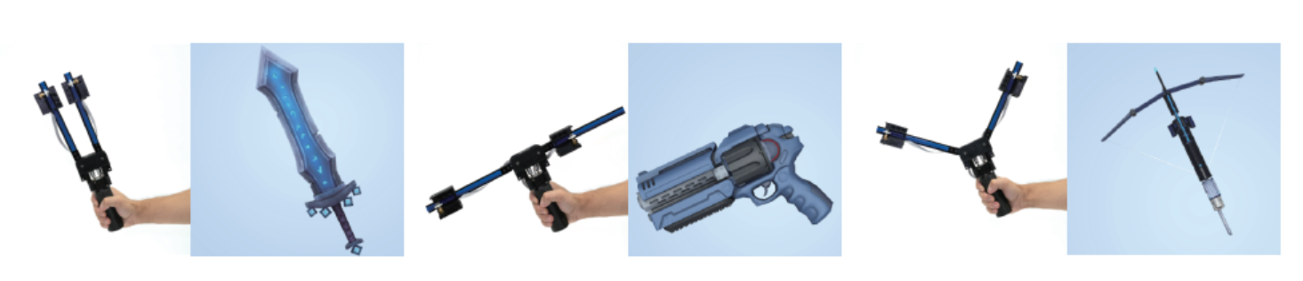
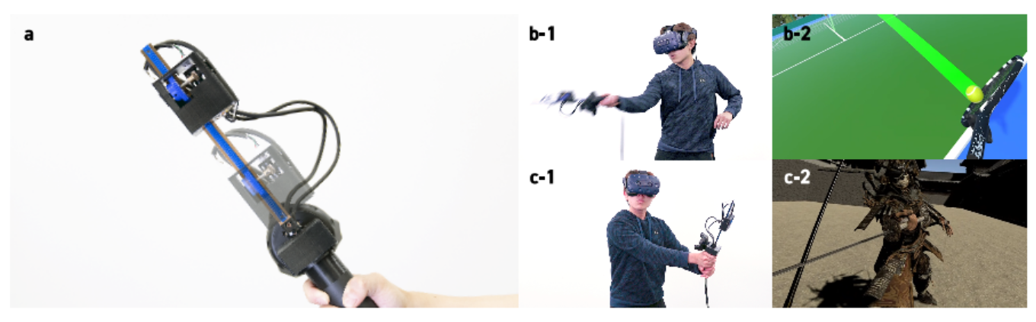
2.literature review
Notes:
feedback of static objects or physical phenomena within a short period

Slide 7
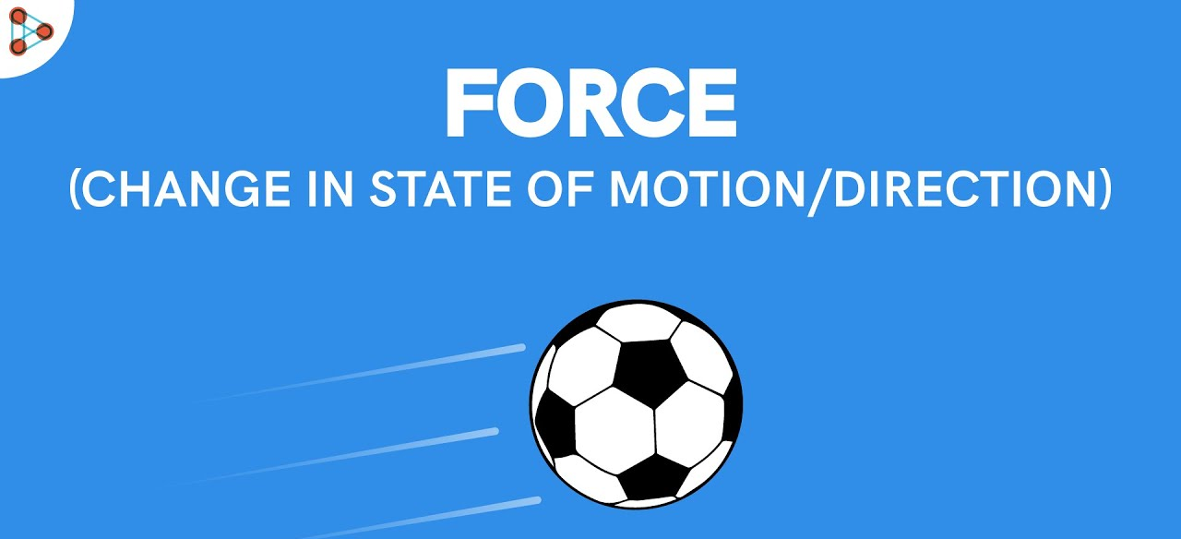
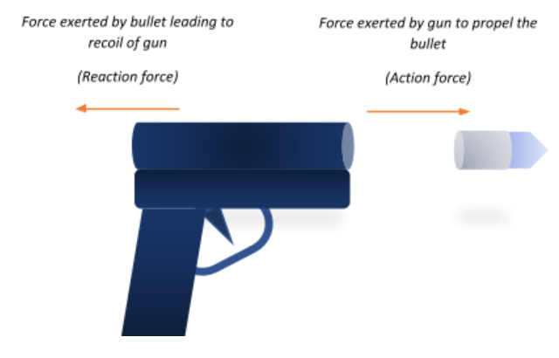

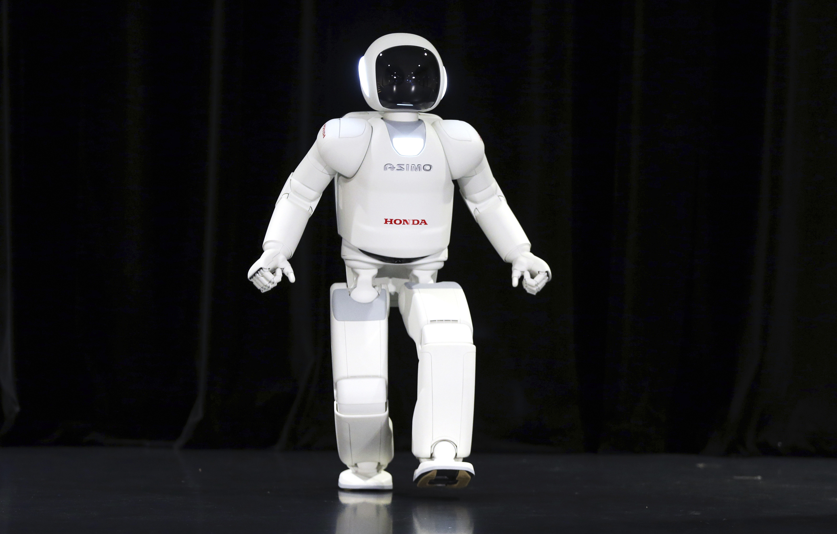
dynamic object & self-motion
Notes:
Less research has been involved in these areas

Slide 8
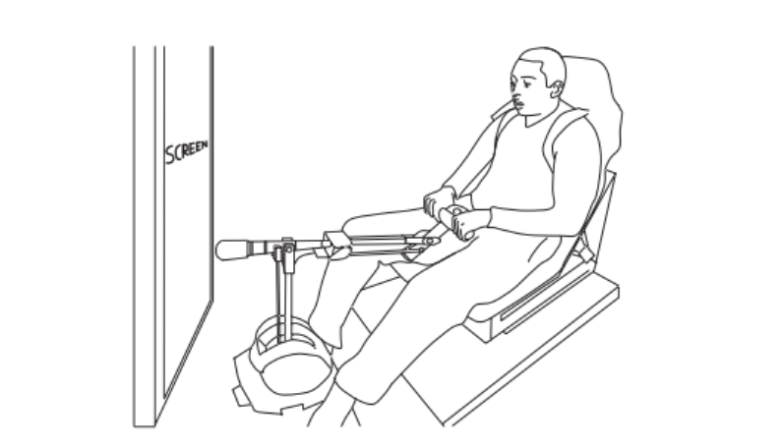
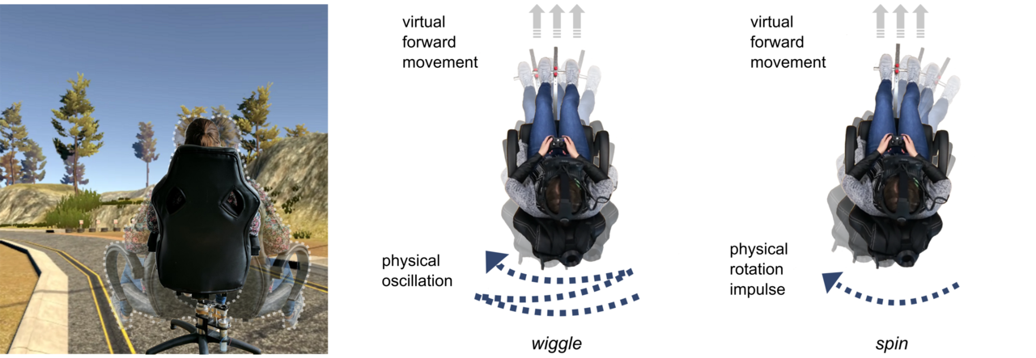
Haptic Motion
Haptic Motion: Improving Sensation of Self-Motion in Virtual Worlds with Force Feedback
Haptic induces frequency and visual induces duration.
Subjective is week with speed, but strong correlated with acceleration and no correlation with direction.
Notes:
Firstly, the equipment is large and fixed
Secondly, the method is by tilting, This method is same with the situation in our real life, but in this virtual environment lack of haptic reference of the surrounding environment itseffect is very limited
Third, the game experience in the virtual environment was mainly studied including immersion and realism, without investigation of the feeling of subjective operation

Slide 9
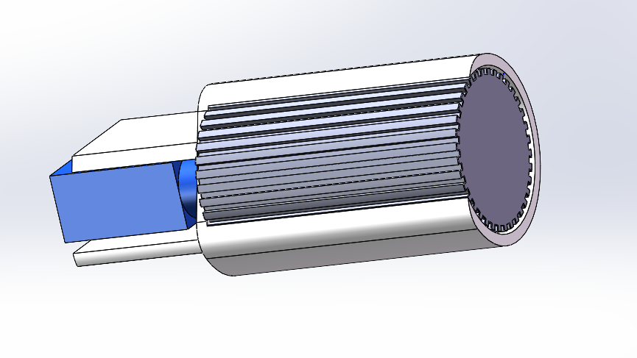
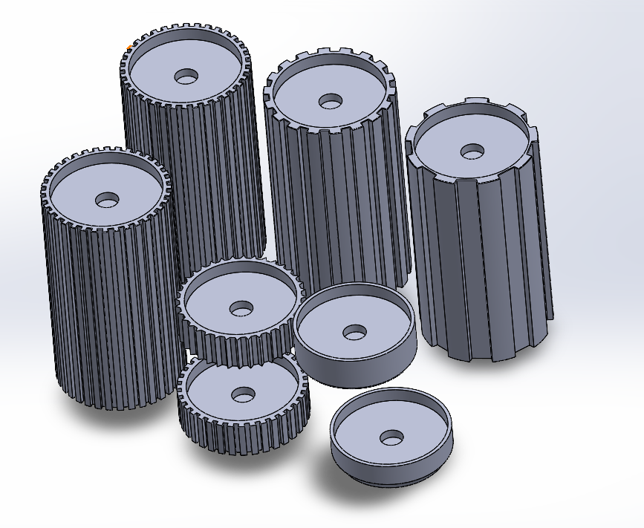
3. concept design
Notes:
my design is using the rotation to represent the displacement of the movement,
compared to tilting it does not need to be fixed in a certain place,
this movement is close to the movement of the tire, so it is also easy to understanding for the user

Slide 10
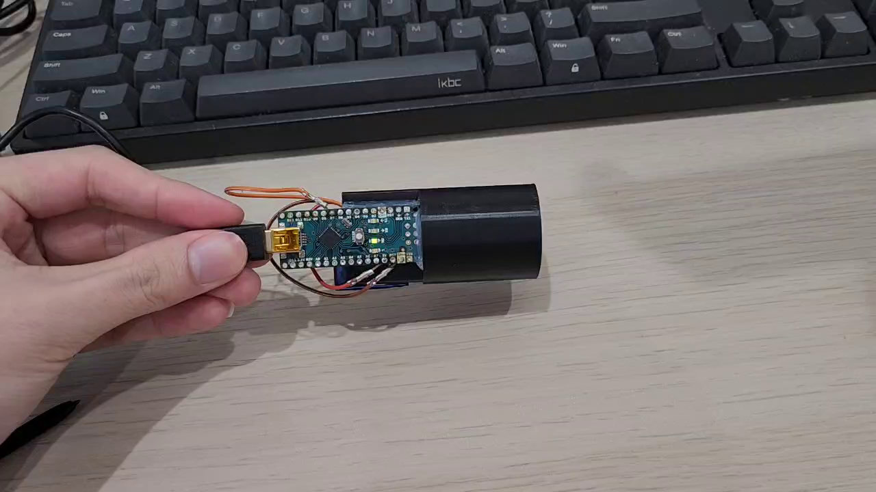
v1 -1dof translation feedback haptic device

Slide 11
Preliminary user test (N =9)
There's a strong sensation regarding the direction.
Desires feedback in the left and right directions.
Holding with one hand and operating with the other creates a serious feeling of disconnection.
Bugs and delay greatly affect the overall immersive physical experience.
A more natural grip is needed.
When used in a video or racing environment, providing a corresponding sense of speed would be more immersive and increase the distance between the user and the racer.

Slide 12
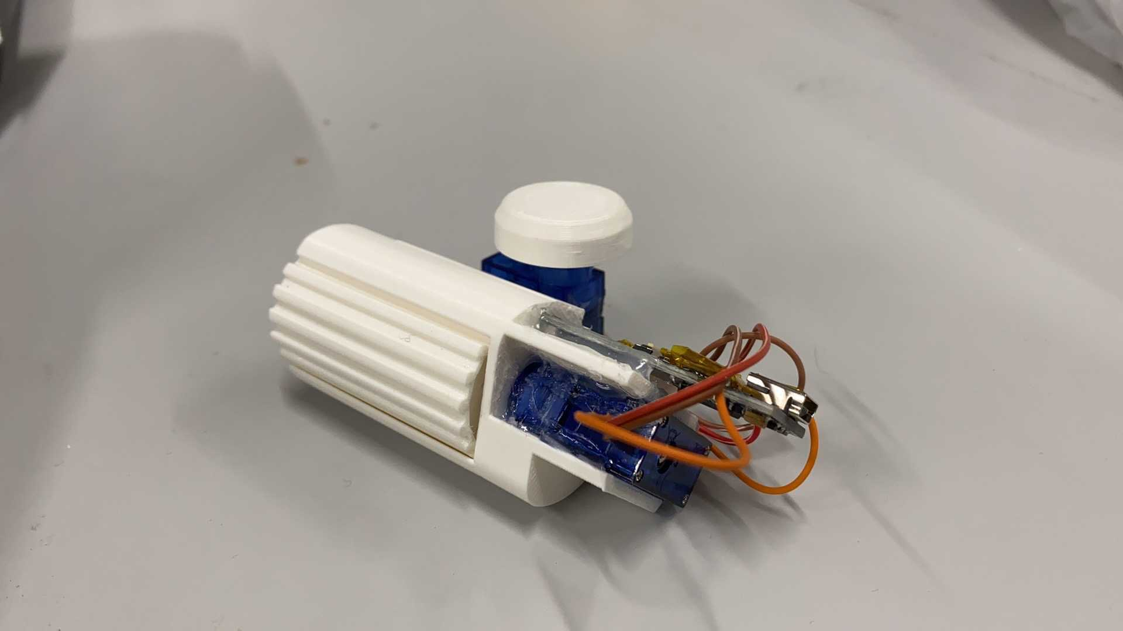
v2

Slide 13
4. proof of concept
The reliability of the device, including the torque and speed output of the device.
Perception of the device, and whether they can feel the motion of the virtual vehicle.
The device can enhance the user experience of automated equipment, including immersion, connectivity, entertainment, and operability.

Slide 14
experiment design
one baseline testing
audio-visual interaction testing.
active interaction testing without device.
active interaction testing with device.
simulated AI controlling testing.

